Slide 1
Version 1.05
UCSD CSE 30
Computer Organization and Systems Programming
Aarch32 Assembly – Part 2
Lecture 15 – November 8, 2022
Keith Muller

Slide 2
Conditional Branch: Changing the Next Instruction to Execute
cmp r3, r4
beq .Ldone
// otherwise fall through do the add
add r1, r2, 1
// now fall through to mov
.Ldone:
mov r3, r1
Branch guard
if (r3 != r4)
r1 = r2 + 1;
r3 = r1;
Condition | Meaning | Flag Checked
BEQ | Equal | Z = 1
B | Always (unconditional)
cmp r3, r4 // r3 – r4
// if r3 != r4 sets Z = 0
How to implement a branch/loop guard in CSE30
Use a cmp/cmm instruction to set the condition bits
Follow the cmp/cmm with one or more variants of the conditional branch instruction
Conditional branch instructions if evaluate to true (based on the flags set by the cmp) the next instruction will the one at the branch label
Otherwise, execution falls through to the instruction that immediately follows the branch
You may have one or more conditional branches after a single cmp/cmm
x

Slide 3
Examples: Guards (Conditional Tests) and their Inverse
Compare in C | "Inverse" Compare in C
== | !=
!= | ==
> | <=
>= | <
< | >=
<= | >
x

Slide 4
Conditional Branch: Changing the Next Instruction to Execute
Branch instruction
bsuffix .Llabel
Bits in the condition field specify the conditions when the branch happens
If the condition evaluates to be true, the next instruction executed is located at .Llabel:
If the condition evaluates to be false, the next instruction executed is located immediately after the branch
Unconditional branch is when the condition is "always"
cond
b
imm24
Condition | Meaning | Flag Checked
BEQ | Equal | Z = 1
BNE | Not equal | Z = 0
BGE | Signed ≥ ("Greater than or Equal") | N = V
BLT | Signed < ("Less Than") | N ≠ V
BGT | Signed > ("Greater Than") | Z = 0 && N = V
BLE | Signed ≤ ("Less than or Equal") | Z = 1 || N ≠ V
BHS | Unsigned ≥ ("Higher or Same") or Carry Set | C = 1
BLO | Unsigned < ("Lower") or Carry Clear | C = 0
BHI | Unsigned > ("Higher") | C = 1 && Z = 0
BLS | Unsigned ≤ ("Lower or Same") | C = 0 || Z = 1
BMI | Minus/negative | N = 1
BPL | Plus - positive or zero (non-negative) | N = 0
BVS | Overflow | V = 1
BVC | No overflow | V = 0
B (BAL) | Always (unconditional)
x

Slide 5
Eliminate unnecessary branches and labels: use Fall Throughs
mov r2, 0
b .Lnext // not needed, slows code
.Lnext:
add r1, r2, r3
mov r2, 0
add r1, r2, r3
Use fall-through!
do not branch to a Label on the next statement!
x

Slide 6
Branching, What not to do: Spaghetti Code
mov r1, 1
mov r2, 2
b .Lthree
mov r5, 5
b .Lsix
.Lthree:
mov r3, 3
mov r4, 4
b .Lseven
.Lsix:
mov r6, 6
.Lseven:
mov r7, 7
Much faster and easier to read!
Observation
Using many branch commands (conditional or unconditional) is an indication you should look to reorganize your code
To the left are many unreachable sections of code
mov r1, 1
mov r2, 2
mov r3, 3
mov r4, 4
mov r7, 7
x

Slide 7
Program Flow: Simple If statement, No Else
Approach: adjust the conditional test then branch around the true block
Use a conditional test that specifies the inverse of the condition used in C
C source Code | Incorrect Assembly | Correct Assembly
int r0; if (r0 == 5) { //code } | cmp r0, 5 beq .Lendif //code .Lendif: | cmp r0, 5 bne .Lendif // code .Lendif:
If r0 == 5 true
then fall through to the true block
If r0 != 5 true
then branch around the true block
int r0;
if (r0 == 5) {
/* code */
/* then fall through */
}
/* branch around to this code */
cmp r0, 5
bne .Lendif
/* code */
/* then fall through */
.Lendif:
/* branch around to this code */
x

Slide 8
Branch Guard "Adjustment" Table Preserving Block Order In Code
Compare in C | "Inverse" Compare in C | "Inverse" Signed Assembly | "Inverse" Unsigned Assembly
== | != | bne | bne
!= | == | beq | beq
> | <= | ble | bls
>= | < | blt | blo
< | >= | bge | bhs
<= | > | bgt | bhi
if (r0 compare 5) {
/* condition true block */
/* then fall through */
}
cmp r0, 5
inverse .Lelse
// condition true block
// then fall through
.Lendif:
x

Slide 9
When do you use a Signed or Unsigned Conditional Branch?
example with 4 bits (arm is 32)
0111₂ > 1100₂ ?
Compare
7 > 12 ?
signed
2's complement
unsigned
Compare
+7 > -4 ?
(FALSE)
(TRUE)
Condition | Suffix For Unsigned Operands: | Suffix For Signed Operands:
> | BHI (Higher Than) | BGT (Greater Than)
>= | BHS (Higher Than or Same) (BCS) | BGE (Greater Than or Equal)
< | BLO (Lower Than) (BCC ) | BLT (Less Than)
<= | BLS (Lower Than or Same) | BLE (Less Than or Equal)
== | BEQ (Equal)
!= | BNE (Not Equal)
x

Slide 10
If statement examples – Branch Around the True block!
cmp r0, 5
bne .Lendif
add r1, r2, r3
add r2, r2, 1
.Lendif:
mov r3, r2
If r0 == 5 false
then branch around the true block
int r0;
if (r0 == 5) {
r1 = r2++ + r3;
}
r3 = r2;
Fall through
cmp r0, 5
bgt .Lendif
mov r1, r2
add r2, r2, 1
.Lendif:
mov r3, r2
int r0;
if (r0 <= 5) {
r1 = r2++;
}
r3 = r2;
Fall through
unsigned int r0, r1;
if (r0 > r1) {
r1 = r0;
}
r3 = r2;
cmp r0, r1
bls .Lendif
mov r1, r0
.Lendif:
mov r3, r2
Fall through
x

Slide 11
Branching: Using Fall through!
Do not do the following:
cmp r0, 0
beq .Lthen
b .Lendif
.Lthen:
add r1, r1, 1
.Lendif:
add r1, r1, 2
Some call this "goto like" structure
Do not use unnecessary branches when a “fall through” works
You can see this by structures that have a conditional branch around an unconditional branch that immediately follows it
Caution!
Two adjacent branches
Do the following:
cmp r0, 0
bne .Lendif
// fall through
add r1, r1, 1
.Lendif:
add r1, r1, 2
x

Slide 12
Anatomy of a Conditional Branch: If - Else statement
Branch condition
Test (branch guard)
if (r0 == 5) {
/* condition block #1 */
} else {
/* condition block #2 */
/ * fall through */
}
condition true block
condition false block
In C, when the branch guard (condition test) evaluates non-zero you fall through to the condition true block, otherwise you branch to the condition false block
Block order: (the order the blocks appear in C code) can be changed by inverting the conditional test, swapping the order of the true and false blocks
if (r0 != 5) {
/* condition block #2 */
} else {
/* condition block #1 */
/* fall through */
}
condition true block
Branch condition
Test (branch guard)
condition false block
x

Slide 13
Program Flow: If with an Else
If r0 == 5 false
then branch to false block
cmp r0, 5
bne .Lelse
/* cond. true block */
/*
* Now branch around the
* condition false block
*/
b .Lendif
.Lelse
// condition false block
// fall through
.Lendif:
mov r1, 4
if (r0 == 5) {
/* cond. true block */
/* branch around false */
} else {
/* condition false block */
/* fall through */
}
r1 = 4;
If r0 == 5 false
then branch to false block
Make the adjustment to the conditional test to branch to the false block
When you finish the true block, you do an unconditional branch around the false block
The false block falls through to the following instructions
x

Slide 14
If with an Else Examples
Branch condition
Test (branch guard)
If r0 < r1 false
then branch to false block
cmp r0, r1
bge .Lelse
mov r2, 1
b .Lendif
.Lelse:
mov r2, 0
/* fall through */
.Lendif:
add r4, r2, r4
…
if (r0 < r1) {
r2 = 1;
// branch around else
} else {
r2 = 0;
/* fall through */
}
r4 = r2 + r4;
condition true block
condition false block
x

Slide 15
If with an Else Block order: All These Are Equivalent
if (r0 < r1) {
r2 = 1;
// now branch around else
} else {
r2 = 0;
/* fall through */
}
r4 = r2 + r4;
if (r0 >= r1) {
r2 = 0;
// now branch around else
} else {
r2 = 1;
/* fall through */
}
r4 = r2 + r4;
cmp r0, r1
bge .Lelse
mov r2, 1
b .Lendif
.Lelse:
mov r2, 0
/* fall through */
.Lendif:
add r4, r2, r4
Same test
swapped blocks
cmp r0, r1
blt .Lelse
mov r2, 0
b .Lendif // around else
.Lelse:
mov r2, 1
/* fall through */
.Lendif:
add r4, r2, r4
cmp r0, r1
bge .Lelse
mov r2, 1
b .Lendif // around else
.Lelse:
mov r2, 0
/* fall through */
.Lendif:
add r4, r2, r4
x

Slide 16
Switch Statement
Approach 1 – Branch Block
Approach 2 – if else equiv.
cmp r0, 1
beq .Lblk1
cmp r0, 2
beq .Lblk2
// fall through
// default 3
b .Lendsw // break
.Lblk1:
// block 1
b .Lendsw // break
.Lblk2:
// block 2
// fall through
// NO b .Lendsw
.Lendsw:
cmp r0, 1
bne .Lblk2
// block 1
b .Lendsw // break
.Lblk2:
cmp r0, 2
bne .Ldefault
// block 2
b .Lendsw // break
.Ldefault:
// default 3
// fall through
// NO b .Lendsw
.Lendsw:
Branch block
switch (r0) {
case 1:
// block 1
break;
case 2:
// block 2
break;
default:
// default 3
break;
}
x

Slide 17
Bad Style: Branching Upwards (When Not a loop)
cmp r3, r4
blt .Lendif
beq .Lelse1
bgt .Lelse2
.Lelse1:
mov r2, 0
b .Lendif
.Lelse2:
add r4, r3, r2
b .Lelse1
.Lendif:
add r4, r2, r4
eliminate this branch
replace with fall through
Do not Branch "Upwards" unless it is part of a loop (later slides)
If you cannot easily write the equivalent C code for your assembly code, you may have code that is harder to read than it should be
Action: adjust your assembly code to have a similar structure as an equivalent version written in C
Upwards
branch
eliminate this branch
cmp r3, r4
blt .Lendif
beq .Lelse1
add r4, r3, r2
.Lelse1:
mov r2, 0
.Lendif:
add r4, r2, r4
x

Slide 18
Program Flow – Short Circuit or Minimal Evaluation
In evaluation of conditional guard expressions, C uses what is called short circuit or minimal evaluation
Each expression argument is evaluated in sequence from left to right including any side effects (modified using parenthesis), before (optionally) evaluating the next expression argument
If after evaluating an argument, the value of the entire expression can be determined, then the remaining arguments are NOT evaluated (for performance)
if ((x == 5) || (y > 3)) // if x == 5 then y > 3 is not evaluated
if ((a != 0) && func(b)) // if a is 0, func(b) is not called
// do_something();
x

Slide 19
Program Flow – If statements && compound tests - 1
If r0 == 5 false
then short circuit branch around the true block
cmp r0, 5
bne .Lendif
cmp r1, 3
ble .Lendif
mov r2, r5 // true block
// fall through
.Lendif:
mov r4, r3
if ((r0 == 5) && (r1 > 3)) {
r2 = r5; // true block
/* fall through */
}
r4 = r3;
x

Slide 20
Program Flow – If statements && compound tests - 2
if r0 == 5 false
then short circuit branch to the false block
cmp r0, 5 // test 1
bne .Lelse
cmp r1, 3 // test 2
ble .Lelse
mov r2, r5 // true block
// branch around else
b .Lendif
.Lelse:
mov r5, r2 //false block
// fall through
.Lendif:
mov r4, r3
if ((r0 == 5) && (r1 > 3)) {
r2 = r5; // true block
// branch around else
} else {
r5 = r2; False block */
/* fall through */
}
r4 = r3;
if r1 > 3 false
then branch to the false block
x

Slide 21
Program Flow – If statements || compound tests - 1
cmp r0, 5
beq .Lthen
cmp r1, 3
ble .Lendif
// fall through
.Lthen:
mov r2, r5 // true block
/* fall through */
.Lendif:
mov r4, r3
If r0 == 5 true, then branch to true block
if ((r0 == 5) || (r1 > 3)) {
r2 = r5; // true block
/* fall through */
}
r4 = r3;
if r1 > 3 false then branch around true block
x

Slide 22
Program Flow – If statements || compound tests - 2
cmp r0, 5
beq .Lthen
cmp r1, 3
ble .Lelse
// fall through
.Lthen:
mov r2, r5 // true block
// branch around else
b .Lendif
.Lelse
mov r5, r2 // false block
// fall through
.Lendif:
If r0 == 5 true, then branch to the true block
if r1 > 3 false then branch to false block
if ((r0 == 5) || (r1 > 3)) {
r2 = r5; // true block
/* branch around else */
} else {
r5 = r2; // false block
/* fall through */
}
x

Slide 23
Program Flow – Pre-test and Post-test Loop Guards
loop guard: code that must evaluate to true before the next iteration of the loop
If the loop guard test(s) evaluate to true, the body of the loop is executed again
pre-test loop guard is at the top of the loop
If the test evaluates to true, execution falls through to the loop body
if the test evaluates to false, execution branches around the loop body
post-test loop guard is at the bottom of the loop
If the test evaluates to true, execution branches to the top of the loop
If the test evaluates to false, execution falls through the instruction following the loop
zero or more iterations
one or more iterations
pre-test
loop guard
while (i < 10) {
/* block */
i++;
}
do {
/* block */
i++;
} while (i < 10);
post-test
loop guard
loop control variable
x

Slide 24
Pre-Test Guards - While Loop
.Lwhile:
cmp r1, 10
bge .Lendw
// block
add r1, r1, 1
b .Lwhile
.Lendw:
mov r2, r1
inverted test
pre-test
loop guard
while (r1 < 10) {
/* block */
r1++;
}
r2 = r1;
loop iteration
.Lwhile:
cmp r1, 10
bge .Lendw
cmp r2, r1
beq .Lnext
// block
.Lnext:
add r1, r1, 1
b .Lwhile
.Lendw:
mov r2, r1
pre-test
loop guard
while (r1 < 10) {
if (r2 != r1) {
/* block */
}
r1++;
}
r2 = r1;
if stmt guard
loop iteration
x

Slide 25
Post-Test Guards – Do While Loop
.Ldo:
// block
add r1, r1, 1
cmp r1, 10
blt .Ldo
mov r2, r1
do {
/* block */
r1++;
} while (r1 < 10);
r2 = r1;
loop iteration
test is not inverted
post-test
loop guard
.Ldo:
cmp r2, r1
beq .Lnext
// block
.Lnext
add r1, r1, 1
cmp r1, 10
blt .Ldo
move r2, r1
do {
if (r2 != r1) {
/* block */
}
r1++;
} while (r1 < 10);
r2 = r1;
loop iteration
post-test
loop guard
x

Slide 26
Program Flow – Counting (For) Loop
Pre loop setup
mov r1, 0
.Lfor:
cmp r1, 10
bge .Lendfr
// block code
add r1, r1, 1
b .Lfor
.Lendfr:
Pre loop setup
Pre-test
Loop guard
Post loop update
Pre-test loop guard
for (r1 = 0; r1 < 10; r1++) {
/* block */
}
Post loop update
A counting loop has three parts:
Pre-loop setup
Pre-test loop guard conditions
Post-loop update
Alternative:
move Pre-test loop guard before the loop
Add post-test loop guard
converts to do while
removes an unconditional branch
Alternative
Pre-loop setup
mov r1, 0
cmp r1, 10
bge .Lendfr
.Ldo:
// block code
add r1, r1, 1
cmp r1, 10
blt .Ldo
.Lendfr:
Pre-test loop guard
Post loop update
Post-test loop guard
x

Slide 27
Nested loops
mov r3, 0
.Lfor:
cmp r3, 10 // loop guard
bge .Lendfor
mov r0, 0
.Ldo:
add r0, r0, r1
add r1, r1, 1
cmp r1, 10 // loop guard
blt .Ldo
// fall through
add r2, r2, r1
add r3, r3, 1 // loop iteration
b .Lfor
.Lendfor:
mov r5, r0
for (r3 = 0; r3 < 10; r3++) {
r0 = 0;
do {
r0 = r0 + r1++;
} while (r1 < 10);
// fall through
r2 = r2 + r1;
}
r5 = r0;
Nest loop blocks as you would in C or Java
Do not branch into the middle of a loop, this is hard to read and is prone to errors
x

Slide 28
Keep loops Properly Nested: Do not branch into the middle of a loop
It is hard to understand and debug loops when you branch into the middle of a loop
Keep loops proper nested
Do not do the following:
.Lloop1:
add r1, r1, 1
.Lloop2:
add r2, r2, 1
add r2, r1, r3
cmp r1, 10
blt .Lloop1
beq .Lend1
add r3, r3, 1
cmp r2, 20
ble .Lloop2
.Lend1:
Bad practice: branch into loop body
x

Slide 29
Version 1.05
UCSD CSE 30
Computer Organization and Systems Programming
Aarch32 Assembly – Part 2
Lecture 16 – November 10, 2022
Keith Muller

Slide 30
What is a Bitwise Operation?
a = | a₇ | a₆ | a₅ | a₄ | a₃ | a₂ | a₁ | a₀
 | <op> | <op> | <op> | <op> | <op> | <op> | <op> | <op>
b = | b₇ | b₆ | b₅ | b₄ | b₃ | b₂ | b₁ | b₀
result = | c₇ | c₆ | c₅ | c₄ | c₃ | c₂ | c₁ | c₀
Bitwise operators are applied independently to each of the corresponding bit positions in each variable
Each bit position of the result depends only on bits in the same bit position within the operands
x

Slide 31
Bitwise (Bit to Bit) Operators in C
output = ~a;
output = a & b;
output = a | b;
output = a ^ b; //EOR
a | ~a
0 | 1
1 | 0
a | b | a & b
0 | 0 | 0
0 | 1 | 0
1 | 0 | 0
1 | 1 | 1
a | b | a | b
0 | 0 | 0
0 | 1 | 1
1 | 0 | 1
1 | 1 | 1
a | b | a ^ b
0 | 0 | 0
0 | 1 | 1
1 | 0 | 1
1 | 1 | 0
& with 1 to let a bit through
& with 0 to set a bit to 0
| with 1 to set a bit to 1
| with 0 to let a bit through
^ with 1 will flip the bit
^ with 0 to let a bit through
Bitwise
NOT
Bitwise
AND
Bitwise
OR
Bitwise
EOR
~ 1100
----
0011
0110
& 1100
----
0100
0110
| 1100
----
1110
0110
^ 1100
----
1010
x

Slide 32
Bitwise Not (vs Boolean Not)
Bitwise NOT
a | ~a
0 | 1
1 | 0
~ 1100
----
0011
in C
int output = ~a;
 | Bitwise Not
number | 0101 1010 0101 1010 1111 0000 1001 0110
~number | 1010 0101 1010 0101 0000 1111 0110 1001
Meaning | Operator | Operator | Meaning
Boolean NOT | !b | ~b | Bitwise NOT
Boolean operators act on the entire value not the individual bits
Type | Operation | result
bitwise | ~0x01 | 1111 1111 1111 1111 1111 1111 1111 1110
Boolean | !0x01 | 0000 0000 0000 0000 0000 0000 0000 0000
x

Slide 33
First Look: Copying Values To Registers – MVN (not)
mvn r0, r1
// Copies all 32 bits
// of the value held
// in register r1 into
// the register r0
// then does a bitwise NOT
register r1
Bitwise NOT
~ 1100
----
0011
register r0
A bitwise NOT operation
0x 0c
mvn r0, 12
// Expands an imm8 value 0x0c
// stored in the instruction
// into a register then does
// a bitwise NOT
0x0c
imm8 expansion
0x0000000c
bitwise not
register r0
0xffff fff3
0xfffffff3
x

Slide 34
mvn – Copies NOT (~) (1's Compliment Copy)
mvn
Rd
rot4
imm8
mvn
Rd
Rm
destination register
constant (immediate value)
destination register
source register
~ 1100
----
0011
mvn Rd, constant // Rd = constant
mvn Rd, Rm // Rd = Rm
Bitwise NOT
bitwise NOT operation. Immediate (constant) version copies to 32-bit register, then does a bitwise NOT
mvn r1, 4 // x = ~4
mvn r1, r5 // x = ~y in C
mvn r1, 0 // x = -1
imm8 | extended imm8 | inverted imm8 | signed base 10
0x00 | 0x00 00 00 00 | 0xff ff ff ff | -1
0xff | 0x00 00 00 ff | 0xff ff ff 00 | -256
invert the bits
copy into 32 bits zero extend
r1
0xfffffffb
0x00000004
0x4
r1
0x55555555
0xaaaaaaaa
r5
r1
0x11111111
0x0
x

Slide 35
Bitwise versus C Boolean Operators
Meaning | Operator | Operator | Meaning
Boolean AND | a && b | a & b | Bitwise AND
Boolean OR | a || b | a | b | Bitwise OR
Boolean NOT | !b | ~b | Bitwise NOT
Boolean operators act on the entire value not the individual bits
& versus &&
0x10 & 0x01 = 0x00 (bitwise)
0x10 && 0x01 = 0x01 (Boolean)
! versus ~
~0x01 = 0xfffffffe (bitwise)
!0x01 = 0x0 (Booelan)
x

Slide 36
Bitwise Instructions
<op>
Rd
Rn
rot4
imm8
<op>
Rd
Rn
Rm
destination
operand 1
Operand 2 constant
destination
operand 1
Operand 2
<op> Rd, Rn, constant // Rd = Rn <op> constant
<op> Rd, constant // Rd = Rd <op> constant
<op> Rd, Rn, Rm // Rd = Rn <op> Rm
Bytes: 0 <= imm8 <= 255 + values from "rotating" rot 4 bits
Bitwise <op> description | C Syntax | Arm <op> Syntax Op2: either register or constant value | Operation
Bitwise AND | a & b | and R_{d}, R_{n}, Op2 | R_{d} = R_{n} & Op2
Bit Clear each bit in Op2 that is a 1, the same bit in R_{d}, is cleared | a & ~b | bic R_{d}, R_{n}, Op2 | R_{d} = R_{n} & ~Op2
Bitwise OR | a | b | orr R_{d}, R_{n}, Op2 | R_{d} = R_{n} | Op2
Exclusive OR | a ^ b | eor R_{d}, R_{n}, Op2 | R_{d} = R_{n} ^ Op2
x

Slide 37
The act (operation) of Masking
Bit masks access/modify specific bits in memory
Masking act of applying a mask to a value with a specific op:
orr: 0 passes bit unchanged, 1 sets bit to 1 (a = b | c; // in C)
eor: 0 passes bit unchanged, 1 inverts the bit (a = b ^ c; // in C)
bic: 0 passes bit unchanged, 1 clears it (a = b & ~c; // in C)
and: 0 clears the bit, 1 passes bit unchanged (a = b & c; // in C)
a = | a₇ | a₆ | a₅ | a₄ | a₃ | a₂ | a₁ | a₀
 | <op> | <op> | <op> | <op> | <op> | <op> | <op> | <op>
b = | b₇ | b₆ | b₅ | b₄ | b₃ | b₂ | b₁ | b₀
result = | c₇ | c₆ | c₅ | c₄ | c₃ | c₂ | c₁ | c₀
x

Slide 38
Mask on and Mask off
force bits to 1 "mask on" operation
1 to set a bit to 1
0 to let a bit through unchanged
orr r1, r2, r3
r1 = r2 | r3; // in C
Example: force lower 8 bits to 1
DATA: r2 0xab ab ab 77
orr r1 r2, 0xff
r1 = r2 | 0xff; // in C
RSLT: r1 0xab ab ff ff
Example: force lower 16 bits to 1
DATA: r2 0xab ab ab 77
orr
MASK: r3 0x00 00 ff ff
RSLT: r1 0xab ab ff ff
unchanged
forces to a 1
x

Slide 39
Mask on and Mask off
force bits to 0 "mask off" operation
0 to set a bit to 0 ("clears the bit")
1 to let a bit through unchanged
and r1, r2, r3
r1 = r2 & r3; // in C
Example: force lower 8 bits to 0
DATA: r2 0xab ab ab 77
and r1 r2, 0xffffff00
r1 = r2 & 0xffffff00; // in C
RSLT: r1 0xab ab ab 00
Example: force lower 8 bits to 0
DATA: r2 0xab ab ab 77
and
MASK: r3 0xff ff ff 00
RSLT: r1 0xab ab ab 00
unchanged
forces to a 0
x

Slide 40
Mask off versus Bit Clear
Example: force only bit 5 to 0
DATA: r2 0xab ab ab 77
and
MASK: r3 0xff ff ff df
RSLT: r1 0xab ab ab 57
r1 = r2 & 0xffffffdf; // In C
77: 0111 0111
force bits to 0 "mask off" operation
0 to set a bit to 0 ("clears the bit")
1 to let a bit through unchanged
and r1, r2, r3
r1 = r2 & r3; // In C
df: 1101 1111
unchanged
forces to a 0
57: 0101 0111
clear bit 5 to a 0 without changing the other bits
DATA: r2 0xab ab ab 77
bic
MASK: r3 0x00 00 00 20
RSLT: r1 0xab ab ab 57
r1 = r2 & ~0x00000020; // in C
clear specific bits which are 1 in a mask, 0 bits in the mask are unchanged
r1 = r2 & ~r3; // in C
bic r1, r2, r3
r3: 0010 0000
~r3: 1101 1111
unchanged
forces to a 0
unchanged
clears bit 5
x

Slide 41
Extracting (Isolate) a Field of Bits with a mask
extract top 8 bits of r2 into r1
0 to set a bit to 0 ("clears the bit")
1 to let a bit through unchanged
and r1, r2, r3
extract top 8 bits of r2 into r1
DATA: r2 0xab ab ab 77
and r1, r2, 0xff000000
RSLT: r1 0xab 00 00 00
r1 = r2 & 0xff000000; // in C
DATA: r2 0xab ab ab 77
and
MASK: r3 0xff 00 00 00
RSLT: r1 0xab 00 00 00
unchanged
forces to a 0
x

Slide 42
Finding if a bit is set
query the status of a bit "bit status" operation
0 to set a bit to 0 ("clears the bit")
1 to let a bit through unchanged
and r1, r2, 0x02
cmp r1, 0
beq .Lendif
// code for is set
.Lendif:
Example is bit 1 set
DATA: r2 0xab ab ab 77
and
MASK: 0x00 00 00 02 is bit 1 set?
RSLT: r1 0x00 00 00 02 != 0 if set
forces to a 0
unchanged
unsigned int r1, r2;
// code
r1 = r2 & 0x02
if (r1 != 0) {
// code for is set
}
unsigned int r2;
// code
if ((r2 & 0x02) != 0) {
// code for is set
}
x

Slide 43
Even/Odd
Even or odd, check LSB (same as mod %2)
check LSB (bit 0) if set then odd, else even
and r1, r2, 0x01
cmp r1, 0x01
bne .Lendif
// code for handling odd numbers
.Lendif:
DATA: r2 0xab ab ab 77
and
MASK: r3 0x00 00 00 01 (mod 2 even or odd)
RSLT: r1 0x00 00 00 01 (odd)
forces to a 0
unchanged
unsigned int r2;
// code
if ((r2 & 0x01) != 0) {
// code for handling odd numbers
}
x

Slide 44
MOD %<power of 2>
Example: %2
DATA: r2 0xab ab ab 77
and
MASK: r3 0x00 00 00 01 (mod 2 even or odd)
RSLT: r1 0x00 00 00 01 (odd)
remainder (mod): num % d where num ≥ 0 and d = 2^{k}
mask = 2^{k} -1 so for mod 16, mask = 16 -1 = 15
and r1, r2, r3
forces to a 0
unchanged
Example: Mod 16
DATA: r2 0xab ab ab 77
and
MASK: r3 0x00 00 00 0f (mod 16)
RSLT: r1 0xab 00 00 07
forces to a 0
unchanged
x

Slide 45
Flipping bits: bit toggle Used in PA8
Example: invert (flip) the lower 8-bits
DATA: r2 0xab ab ab 77
eor
MASK: r3 0x00 00 00 ff
RSLT: r1 0xab ab ab 88
77: 0111 0111
invert (flip) bits "bit toggle" operation
1 will flip the bit
0 to let a bit through
eor r1, r2, r3
Observation: When applied twice, it returns the original value (symmetric encoding)
With a mask of all 1's is a 1's compliment
unchanged
inverts (flips)
88: 1000 1000
DATA: r1 0xab ab ab 88
eor
MASK: r3 0x00 00 00 ff apply a 2nd time
RSLT: r1 0xab ab ab 77 original value!
Example: flip the lower 8-bits
eor r1, r2, 0xff
inverts (flips)
unsigned int r1, r2;
r1 = r2 ^ 0xff;
x

Slide 46
Shift and Rotate Instructions
<inst>
Rd
Rm
const5
<inst>
Rd
Rm
Rs
destination
operand 1
operand 2 constant
destination
operand 1
operand 2
Number of bit to shift or rotate: const5
Number of bit to shift or rotate: Rs
Instruction | Syntax | Operation | Notes | Diagram
Logical Shift Left int x; or unsigned int x x << n; | LSL R_{d}, R_{m}, const5 LSL R_{d}, R_{m}, R_{s} | R_{d} ← R_{m} << const5 R_{d} ← R_{m} << R_{s} | Zero fills shift: 0 - 31
Logical Shift Right unsigned int x; x >> n; | LSR R_{d}, R_{m}, const5 LSR R_{d}, R_{m}, R_{s} | R_{d} ← R_{m} >> const5 R_{d} ← R_{m} >> R_{s} | Zero fills shift: 1 - 32
Arithmetic Shift Right int x; x >> n; | ASR R_{d}, R_{m}, const5 ASR R_{d}, R_{m}, R_{s} | R_{d} ← R_{m} >> const5 R_{d} ← R_{m} >> R_{s} | Sign extends shift: 1 - 32
Rotate Right unsigned int x; x = (x>>n)|(x<<(32-n)) ; | ROR R_{d}, R_{m}, const5 ROR R_{d}, R_{m}, R_{s} | R_{d} ← R_{m} ror const5 R_{d} ← R_{m} ror R_{s} | right rotate rot: 0 - 31
x

Slide 47
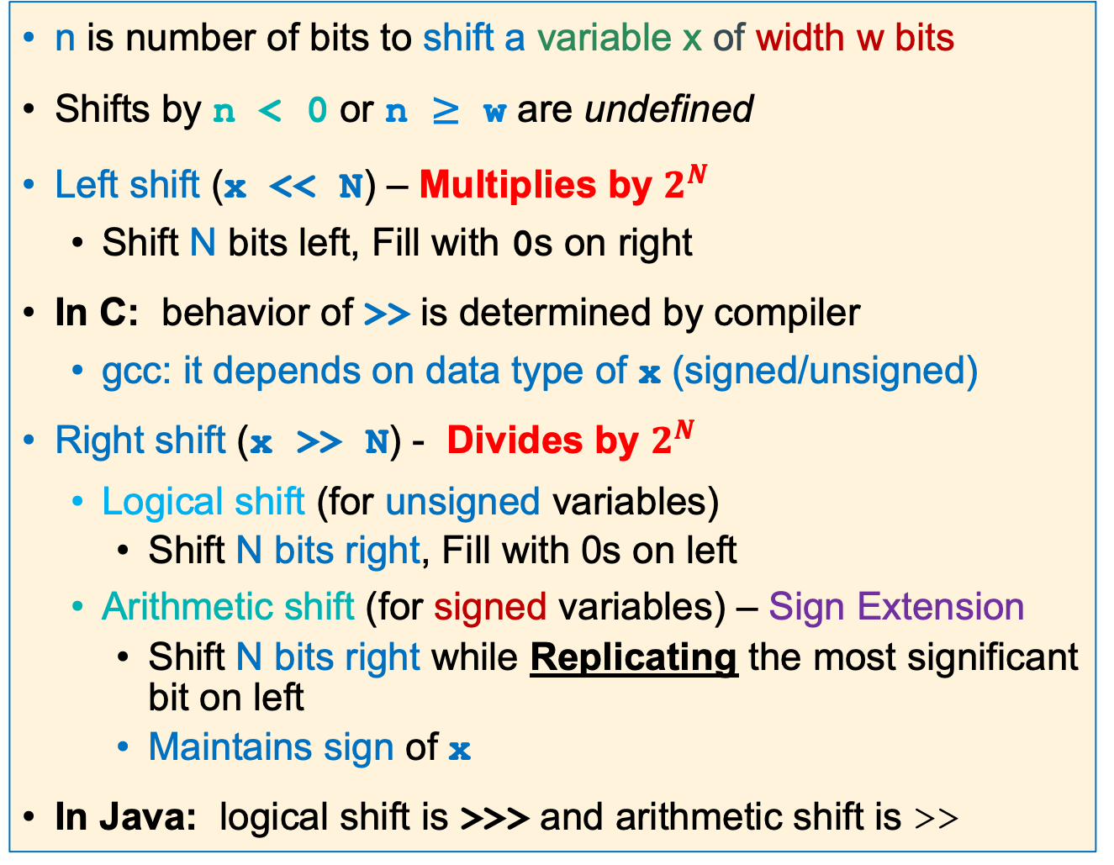
Shift Operations in C
n is number of bits to shift a variable x of width w bits
Shifts by n < 0 or n ≥ w are undefined
Left shift (x << N) – Multiplies by $2^{N}$
Shift N bits left, Fill with 0s on right
In C: behavior of >> is determined by compiler
gcc: it depends on data type of x (signed/unsigned)
Right shift (x >> N) - Divides by $2^{N}$
Logical shift (for unsigned variables)
Shift N bits right, Fill with 0s on left
Arithmetic shift (for signed variables) – Sign Extension
Shift N bits right while Replicating the most significant bit on left
Maintains sign of x
In Java: logical shift is >>> and arithmetic shift is >>
Left Shift
Right logical Shift
Right Arithmetic Shift
x

Slide 48
Arithmetic Shift Right (there is no arithmetic shift left)
asr r2, r0, 8
r0 0xab ab ab 77
r2 0xff ab ab ab (see the sign extend)
Test for sign
-1 if r0 negative
Test for sign
0 if r0 positive
int i;
//code
if ((i>>31) == -1) {
// code neg #
}
asr r2, r0, 31
cmp r2, -1
bne .Lendif
//code neg #
.Lendif:
asr r2, r0, 31
cmp r2, 0
bne .Lendif
//code positive #
.Lendif:
int i;
//code
if ((i>>31) == 0) {
// code pos #
}
r0 0xab ab ab 77
r2 0xff ff ff ff
r0 0x7b ab ab 77
r2 0x00 00 00 00
x

Slide 49
Logical Shift & Rotate Operations
lsr r2, r0, 8
r0 0xab ab ab 77
r2 0x00 ab ab ab
lsl r2, r0, 8
r0 0xab ab ab 77
r2 0xab ab 77 00
ror r2, r0, 8
r0 0xab ab ab 77
r2 0x77 ab ab ab
x

Slide 50
Extracting/Isolating Unsigned Bitfields
Move byte 2 in r0 to byte 0 in r1
Hint: Useful for PA8
31 |  |  |  |  |  |  | 24 | 23 |  |  |  |  |  |  | 16 | 15 |  |  |  |  |  |  | 8 | 7 |  |  |  |  |  |  | 0
 |  |  |  |  |  |  |  | 1 | 0 | 1 | 0 | 1 | 0 | 1 | 0
byte 3
byte 2
byte 1
byte 0
r0
next shift left = 8
pushed bits to far left
31 |  |  |  |  |  |  | 24 | 23 |  |  |  |  |  |  | 16 | 15 |  |  |  |  |  |  | 8 | 7 |  |  |  |  |  |  | 0
1 | 0 | 1 | 0 | 1 | 0 | 1 | 0 |  |  |  |  |  |  |  |  |  |  |  |  |  |  |  |  | 0 | 0 | 0 | 0 | 0 | 0 | 0 | 0
byte 3
byte 2
byte 1
byte 0
lsl r1, r0, 8
unsigned int r0,r1;
r1 = r0 << 8;
r1
Next shift right = 24
pushed bits to far right
31 |  |  |  |  |  |  | 24 | 23 |  |  |  |  |  |  | 16 | 15 |  |  |  |  |  |  | 8 | 7 |  |  |  |  |  |  | 0
0 | 0 | 0 | 0 | 0 | 0 | 0 | 0 | 0 | 0 | 0 | 0 | 0 | 0 | 0 | 0 | 0 | 0 | 0 | 0 | 0 | 0 | 0 | 0 | 1 | 0 | 1 | 0 | 1 | 0 | 1 | 0
byte 3
byte 2
byte 1
byte 0
lsr r1, r1, 24
r1 = r1 >> 24;
r1
unsigned zero-extension (all 0’s)
Extracted bit-field
x

Slide 51
Extracting Signed Bitfields
Move byte 2 in r0 to byte 0 in r1
31 |  |  |  |  |  |  | 24 | 23 |  |  |  |  |  |  | 16 | 15 |  |  |  |  |  |  | 8 | 7 |  |  |  |  |  |  | 0
 |  |  |  |  |  |  |  | 1 | 0 | 1 | 0 | 1 | 0 | 1 | 0
byte 3
byte 2
byte 1
byte 0
r0
next shift left = 8
pushed bits to far left
31 |  |  |  |  |  |  | 24 | 23 |  |  |  |  |  |  | 16 | 15 |  |  |  |  |  |  | 8 | 7 |  |  |  |  |  |  | 0
1 | 0 | 1 | 0 | 1 | 0 | 1 | 0 |  |  |  |  |  |  |  |  |  |  |  |  |  |  |  |  | 0 | 0 | 0 | 0 | 0 | 0 | 0 | 0
byte 3
byte 2
byte 1
byte 0
lsl r1, r0, 8
int r0,r1;
r1 = r0 << 8;
r1
next shift right = 24
31 |  |  |  |  |  |  | 24 | 23 |  |  |  |  |  |  | 16 | 15 |  |  |  |  |  |  | 8 | 7 |  |  |  |  |  |  | 0
1 | 1 | 1 | 1 | 1 | 1 | 1 | 1 | 1 | 1 | 1 | 1 | 1 | 1 | 1 | 1 | 1 | 1 | 1 | 1 | 1 | 1 | 1 | 1 | 1 | 0 | 1 | 0 | 1 | 0 | 1 | 0
pushed bits to far right
byte 3
byte 2
byte 1
byte 0
asr r1, r1, 24
r1 = r1 >> 24;
r1
signed extend (all 1’s)
Extracted
bit-field
x

Slide 52
Inserting Bitfields – Inserting Source Field into Destination Field
31 |  |  |  |  |  |  |  |  |  |  |  |  |  |  |  |  |  |  |  |  |  | 8 | 7 |  |  |  |  |  |  |  | 0
other bits |  |  |  |  |  |  |  |  |  |  |  |  |  |  |  |  |  |  |  |  |  |  | source
Task: Insert source into destination
r0
31 |  |  |  |  |  |  | 24 | 23 |  |  |  |  |  |  |  | 16 | 1 5 |  |  |  |  |  |  |  |  |  |  |  |  |  | 0
do not change |  |  |  |  |  |  |  | destination |  |  |  |  |  |  |  |  | do not change
a | b | a | b
0 | 0 | 0
0 | 1 | 1
1 | 0 | 1
1 | 1 | 1
r1
31 |  |  |  |  |  |  | 24 | 23 |  |  |  |  |  |  |  | 16 | 1 5 |  |  |  |  |  |  |  |  |  |  |  |  |  | 0
all zero's |  |  |  |  |  |  |  | source |  |  |  |  |  |  |  |  | all zero's
Approach
(1) isolate source field
(2) clear destination field
(3) Bitwise or together
r2
31 |  |  |  |  |  |  | 24 | 23 |  |  |  |  |  |  |  | 16 | 1 5 |  |  |  |  |  |  |  |  |  |  |  |  |  | 0
do not change |  |  |  |  |  |  |  | all zeros |  |  |  |  |  |  |  |  | do not change
orr r1, r1, r2
r1 = r1 | r2;
r1
results in
31 |  |  |  |  |  |  | 24 | 23 |  |  |  |  |  |  |  | 16 | 1 5 |  |  |  |  |  |  |  |  |  |  |  |  |  | 0
do not change |  |  |  |  |  |  |  | source |  |  |  |  |  |  |  |  | do not change
r1
x

Slide 53
Inserting Bitfields – Isolating the Source Field
31 |  |  |  |  |  |  |  |  |  |  |  |  |  |  |  |  |  |  |  |  |  | 8 | 7 |  |  |  |  |  |  |  | 0
other bits |  |  |  |  |  |  |  |  |  |  |  |  |  |  |  |  |  |  |  |  |  |  | source
r0
31 |  |  |  |  |  |  | 24 | 23 |  |  |  |  |  |  | 16 | 15 |  |  |  |  |  |  | 8 | 7 |  |  |  |  |  |  | 0
1 | 1 | 1 | 1 | 1 | 1 | 1 | 1 | 1 | 1 | 1 | 1 | 1 | 1 | 1 | 1 | 1 | 1 | 1 | 1 | 1 | 1 | 1 | 0 | 1 | 0 | 1 | 0 | 1 | 0 | 1 | 0
r0
31 |  |  |  |  |  |  | 24 | 23 |  |  |  |  |  |  |  | 16 | 1 5 |  |  |  |  |  |  |  |  |  |  |  |  |  | 0
all zero's |  |  |  |  |  |  |  | source |  |  |  |  |  |  |  |  | all zero's
isolate source field
lsl r2, r0, 24
lsr r2, r2, 8
r2 = r0 << 24;
r2 = r2 >> 8;
r2
0 | 0 | 0 | 0 | 0 | 0 | 0 | 0 | 1 | 0 | 1 | 0 | 1 | 0 | 1 | 0 | 0 | 0 | 0 | 0 | 0 | 0 | 0 | 0 | 0 | 0 | 0 | 0 | 0 | 0 | 0 | 0
r2
x

Slide 54
Inserting Bitfields – Clearing the Destination Field
31 |  |  |  |  |  |  | 24 | 23 |  |  |  |  |  |  |  | 16 | 1 5 |  |  |  |  |  |  |  |  |  |  |  |  |  | 0
do not change |  |  |  |  |  |  |  | destination |  |  |  |  |  |  |  |  | do not change
r1
1 | 0 | 1 | 0 | 1 | 0 | 1 | 0 | 1 | 1 | 1 | 0 | 1 | 1 | 1 | 1 | 1 | 0 | 1 | 0 | 1 | 0 | 1 | 0 | 1 | 0 | 1 | 0 | 1 | 0 | 1 | 0
r1
clear the destination field
ror r1, r1, 24
r1=(r1>>24)|(r1<<8);
1 | 1 | 1 | 0 | 1 | 1 | 1 | 1 | 1 | 0 | 1 | 0 | 1 | 0 | 1 | 0 | 1 | 0 | 1 | 0 | 1 | 0 | 1 | 0 | 1 | 0 | 1 | 0 | 1 | 0 | 1 | 0
r3
lsl r1, r1, 8
r1 = r1 << 8;
1 | 0 | 1 | 0 | 1 | 0 | 1 | 0 | 1 | 0 | 1 | 0 | 1 | 0 | 1 | 0 | 1 | 0 | 1 | 0 | 1 | 0 | 1 | 0 | 0 | 0 | 0 | 0 | 0 | 0 | 0 | 0
r1
31 |  |  |  |  |  |  | 24 | 23 |  |  |  |  |  |  |  | 16 | 1 5 |  |  |  |  |  |  |  |  |  |  |  |  |  | 0
do not change |  |  |  |  |  |  |  | all zeros |  |  |  |  |  |  |  |  | do not change
ror r1, r1, 16
r1= (r1>>16)|(r1<<16);
1 | 0 | 1 | 0 | 1 | 0 | 1 | 0 | 0 | 0 | 0 | 0 | 0 | 0 | 0 | 0 | 1 | 0 | 1 | 0 | 1 | 0 | 1 | 0 | 1 | 0 | 1 | 0 | 1 | 0 | 1 | 0
r1
x

Slide 55
Inserting Bitfields – Combining Isolated Source and Cleared Destination
31 |  |  |  |  |  |  | 24 | 23 |  |  |  |  |  |  |  | 16 | 1 5 |  |  |  |  |  |  |  |  |  |  |  |  |  | 0
all zero's |  |  |  |  |  |  |  | source |  |  |  |  |  |  |  |  | all zero's
r2
isolated source
0 | 0 | 0 | 0 | 0 | 0 | 0 | 0 | 1 | 0 | 1 | 0 | 1 | 0 | 1 | 0 | 0 | 0 | 0 | 0 | 0 | 0 | 0 | 0 | 0 | 0 | 0 | 0 | 0 | 0 | 0 | 0
r2
31 |  |  |  |  |  |  | 24 | 23 |  |  |  |  |  |  |  | 16 | 1 5 |  |  |  |  |  |  |  |  |  |  |  |  |  | 0
do not change |  |  |  |  |  |  |  | all zeros |  |  |  |  |  |  |  |  | do not change
field cleared in destination
r1
1 | 0 | 1 | 0 | 1 | 0 | 1 | 0 | 0 | 0 | 0 | 0 | 0 | 0 | 0 | 0 | 1 | 0 | 1 | 0 | 1 | 0 | 1 | 0 | 1 | 0 | 1 | 0 | 1 | 0 | 1 | 0
r1
inserted field
orr r1, r1, r0
r1 = r1 | r0;
1 | 0 | 1 | 0 | 1 | 0 | 1 | 0 | 1 | 0 | 1 | 0 | 1 | 0 | 1 | 0 | 1 | 0 | 1 | 0 | 1 | 0 | 1 | 0 | 1 | 0 | 1 | 0 | 1 | 0 | 1 | 0
r1
x

Slide 56
Masking Summary
Select a field: Use and with a mask of one's surrounded by zero's to select the bits that have a 1 in the mask, all other bits will be set to zero
selects this field when used with and
0 0 0 0 0 0 0 0 | 1 1 1 1 1 1 1 1 1 | 0 0 0 0 0 0 0 0 0 0 0 0 0 0
selection mask
Clear a field: Use and with a mask of zero's surrounded by one's to select the bits that have a 1 in the mask, all other bits will be set to zero
clears this field when used with and
1 1 1 1 1 1 1 1 | 0 0 0 0 0 0 0 0 0 | 1 1 1 1 1 1 1 1 1 1 1 1 1 1 1
clear a field mask
Isolate a field: Use lsr, lsl, rot to get a field surrounded by zeros
0 0 0 0 0 0 0 0 | source | 0 0 0 0 0 0 0 0 0 0 0 0 0 0 0
lsl to get this edge into msb
lsr to get this edge into lsb
Insert a field: Use orr with fields surrounded by zeros
0 0 0 0 0 0 0 0 | source | 0 0 0 0 0 0 0 0 0 0 0 0 0 0 0
Keep these bits | 0 0 0 0 0 0 0 0 | Keep these bits
x

Slide 57
Extra Slides

Slide 58
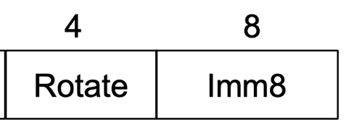
How are I – Type Constants Encoded in the instruction?
Aarch32 provides only 8-bits for specifying an immediate constant value
Without "rotation" immediate values are limited to the range of positive 0-255
Imm8 expands to 32 bits and does a rotate right to achieve additional constant values (YUCK)
positions to
rotate X 2
unsigned value to rotate
rot4 value | 32-bit constant result
0000 | 0000 0000 0000 0000 0000 0000 1111 1111
0001 (2 bits) | 1100 0000 0000 0000 0000 0000 0011 1111
results are interpreted as a 2's complement number
two bits rotated right
x

Slide 59
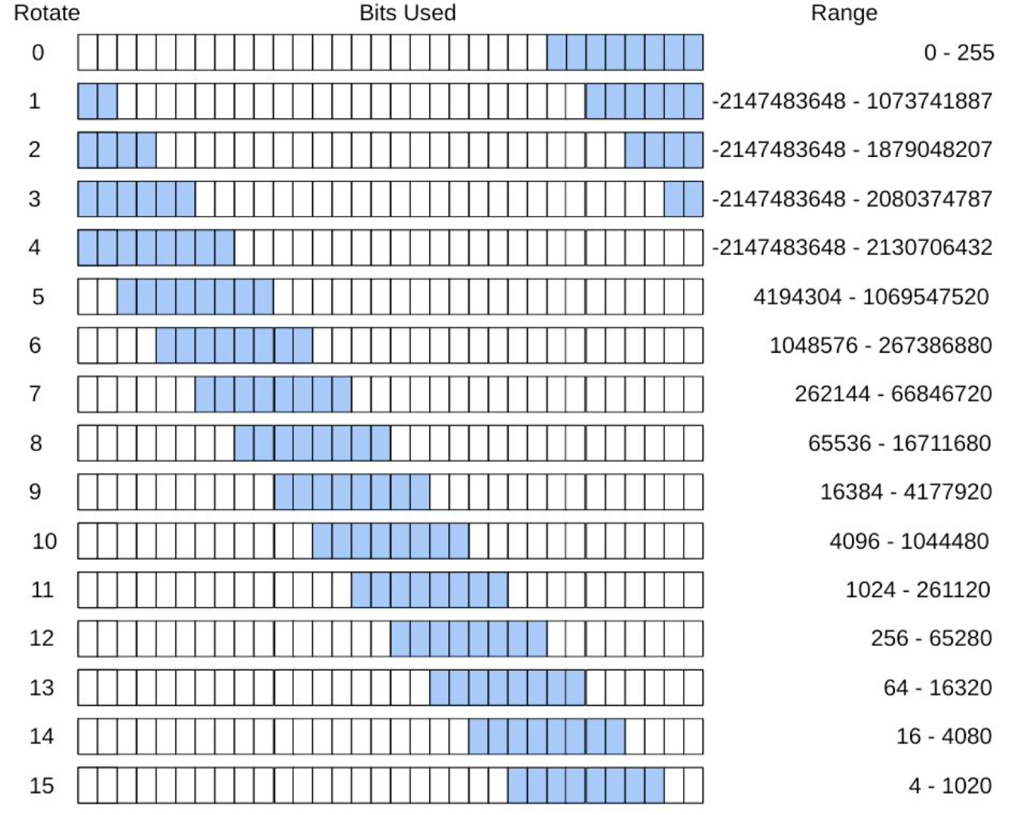
Rot4 - Imm8 Values
positions to
rotate X 2
unsigned value to rotate
How would 256 be encoded?
rotate = 12, imm8 = 1
Bottom line: the assembler will do this for you
If you try and use an immediate value that it cannot generate it will give an error
There is a workaround - later
00000001
results are interpreted as a 2's complement number
x

Slide 60
Branch Target Address (BTA): What Is imm24?
0001042c <inloop>:
1042c: e3530061 cmp r3, 0x61
10430: ba000002 blt 10440 <store>
10434: e353007a cmp r3, 0x7a
10438: ca000000 bgt 10440 <store>
1043c: e2433020 sub r3, r3, #32
00010440 <store>:
10440: e7c13002 strb r3, [r1, r2]
10444: e2822001 add r2, r2, 0x1
10448: e7d03002 ldrb r3, [r0, r2]
1044c: e3530000 cmp r3, 0x0
10450: 1afffff5 bne 1042c <inloop>
executing instruction
decode instruction
fetch instruction
Previous slide: phases of execution: (1) fetch, (2) decode, (3) execute
The pc (r15) contains the address of the instruction being fetched, which is two instructions ahead or executing instruction + 8 bytes
Branch target address (or imm24) is the distance measured in the # of instructions (signed, 2's complement) from the fetch address contained in r15 when executing the branch
BTA: + 2 instructions
target address = 0x10440
fetch address = 0x10438
distance(bytes) = 0x00008
distance(instructions)= 0x8/(4 bytes/instruction)= 0x2
imm24 | 0x 00 00 02
x

Slide 61
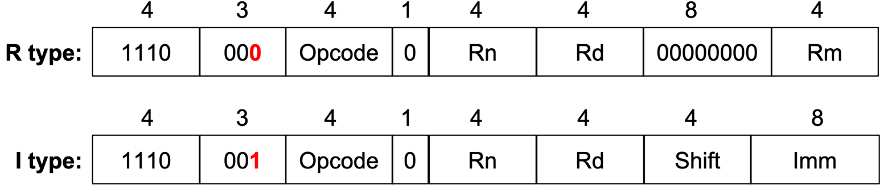
Basic Arm Machine Code Instructions
Instructions consist of several fields that encode the opcode and arguments to the opcode
Special fields enable extended functionality - later
Several 4-bit operand fields for specifying the source and destination of the operation, usually one of the 16 registers
Embedded constants ("immediate values") of various size and "configuration"
Basic Data processing instruction formats (below)
R type instruction: add r0, r1, r2 // third operand is a register
I type instruction: add r0, r0, 1 // third operand is an immediate value
Rotate
x

Slide 62
Program Flow – multiple branches, one cmp
if ((r0 > 5) {
/* condition block 1 */
// branch to endif
} else if (r0 < 5){
/* condition block 2 */
// branch to endif
} else {
/* condition block 3 */
// fall through to endif
}
// endif
r1 = 11;
cmp r0, 5
bgt .Lblk1
blt .Lblk2
// fall through
// condition block 3
b .Lendif
.Lblk1:
// condition block 1
b .Lendif
.Lblk2:
// condition block 2
b .Lendif
.Lendif:
mov r1, 5
special case: multiple branches from one cmp
There are many other ways to do this
x

